Slide 1
Breathe App
Brian Thompson

Slide 2
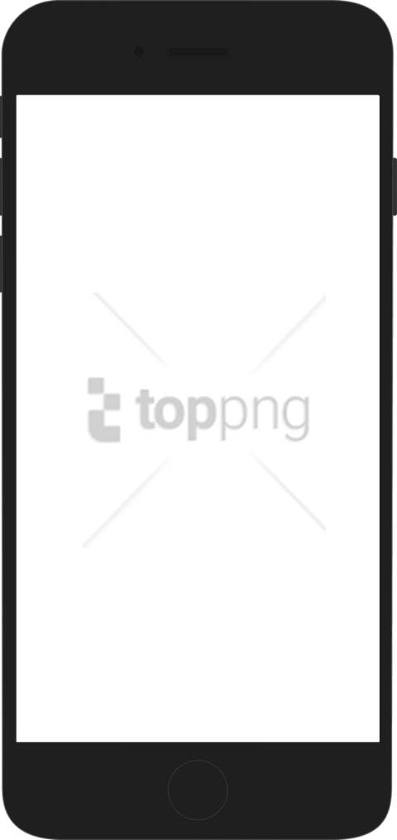
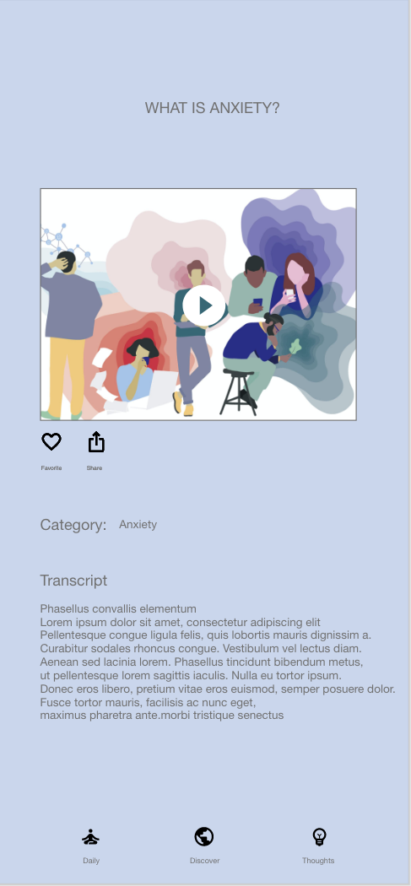
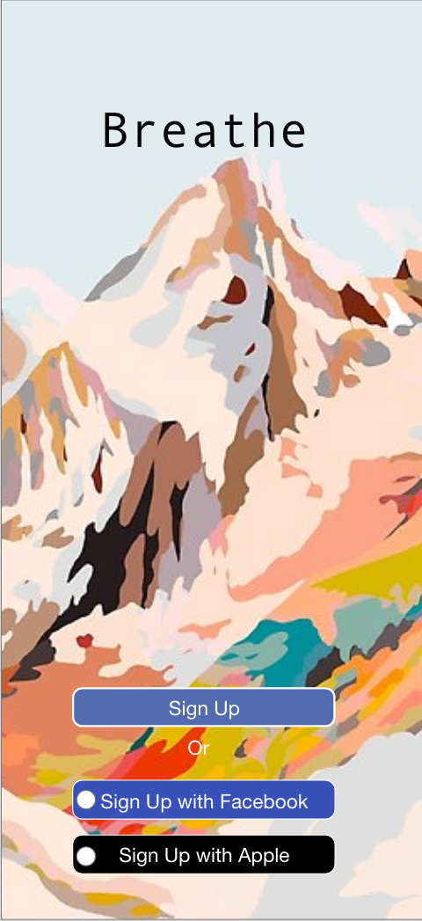
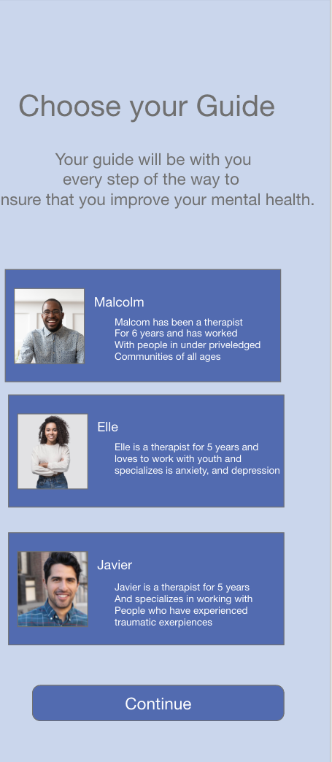
Project overview
The product:
The Breathe app is designed for those that are in communities with limited resources that need mental health resources. The app features a professional mental health expert that guides the user every step of the way
Project duration:
January 2021- February 2021

Slide 3
Project overview
The problem:
In certain states that have a big minority population, these are communities that don’t have many resources for mental health or don’t even know where to start to get help.
The goal:
The goal of this app is to provide a free way for users to get mental health resources daily, and change their situation so that they can get better mentally.

Slide 4
Project overview
My role:
UX Designer and UX Researcher from start to finish.
Responsibilities:
Conduct interviews, paper and digital wireframing, low and high fidelity prototyping, conducting usability studies, accounting for accessibility, iterating on designs and responsive design

Slide 5
User research
Personas
Problem statements
Competitive audit
Ideation
Understanding
the user

Slide 6
User research: summary
The research included a unmoderated study, where participants completed the study remotely. 5 Participants where included in the study that included 2 females, 2 males, and one non-binary individual. The study lasted 30 minutes for each individual and were asked follow-up questions after the prompt they just finished on the main user flow, which was to complete the daily tasks from your selected guide and complete a journal.

Slide 7
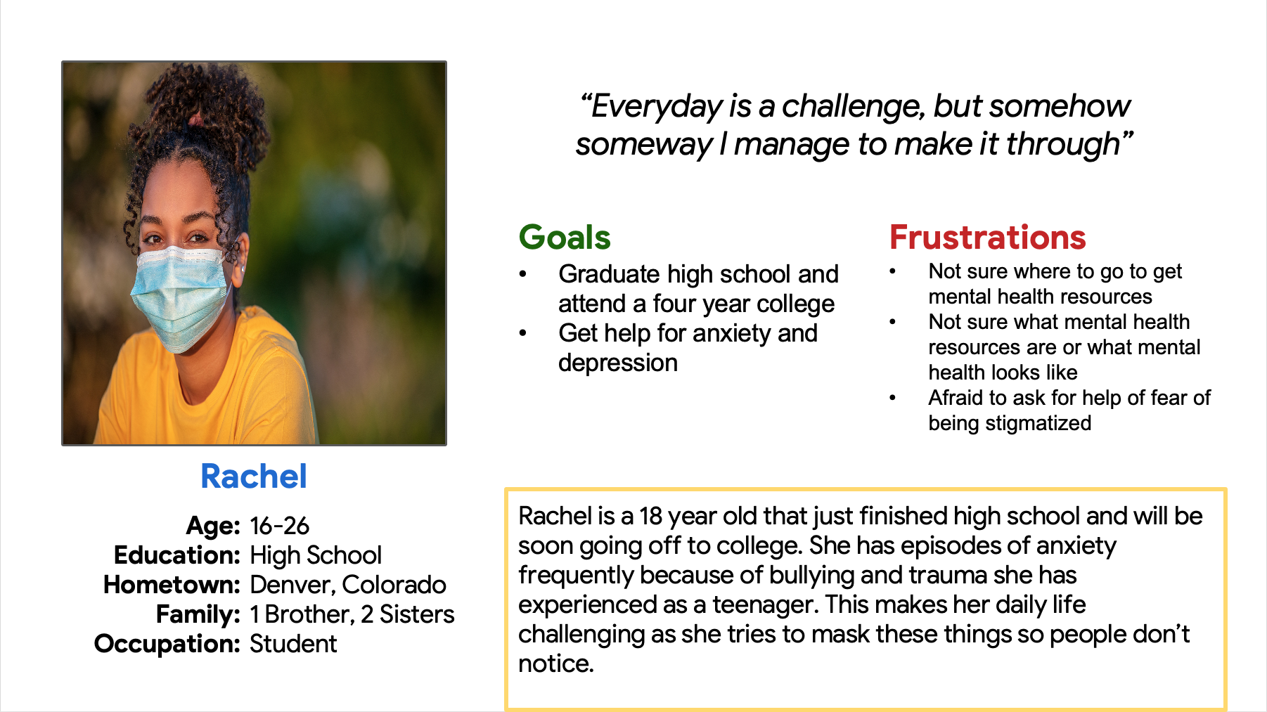
Persona 1: Rachel
Problem statement:
Rachel is a full time student with anxiety and depression who needs mental health resources
because she wants to be able to be herself.

Slide 8
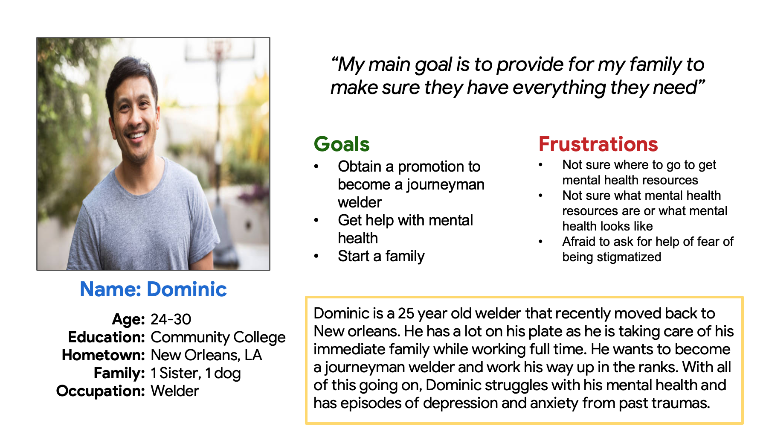
Persona 2: Dominic
Problem statement:
Dominic is a welder and caregiver who needs resources for his mental health because
he wants to combat his anxiety and depression.

Slide 9
Ideation
This is a crazy 8’s activity where I ideated on different possibilities that could be included in the Breathe App.
Image of ideation exercise

Slide 10
Digital wireframes
Low-fidelity prototype
Usability studies
Starting
the design

Slide 11
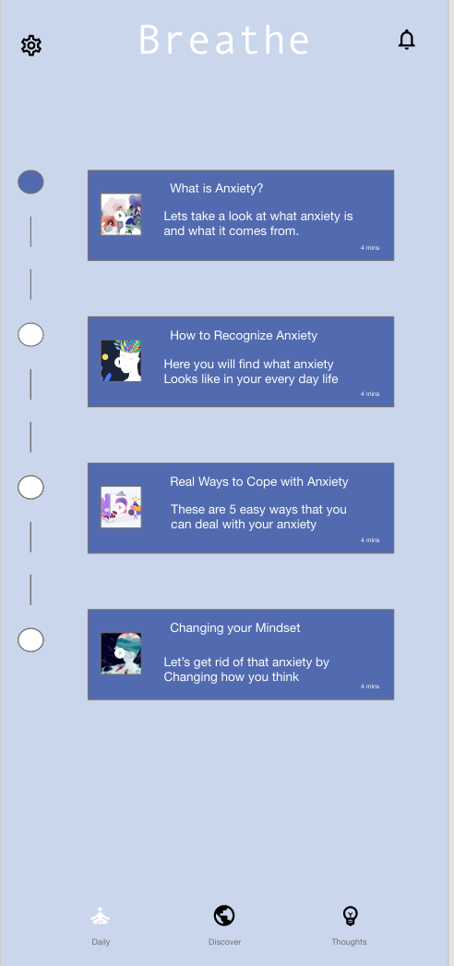
Digital wireframes
Digital wireframes
Description of the element and its benefit to the user
[Your notes about goals and thought process + how you responded to and implemented peer feedback]
Description of the element and its benefit to the user

Slide 12
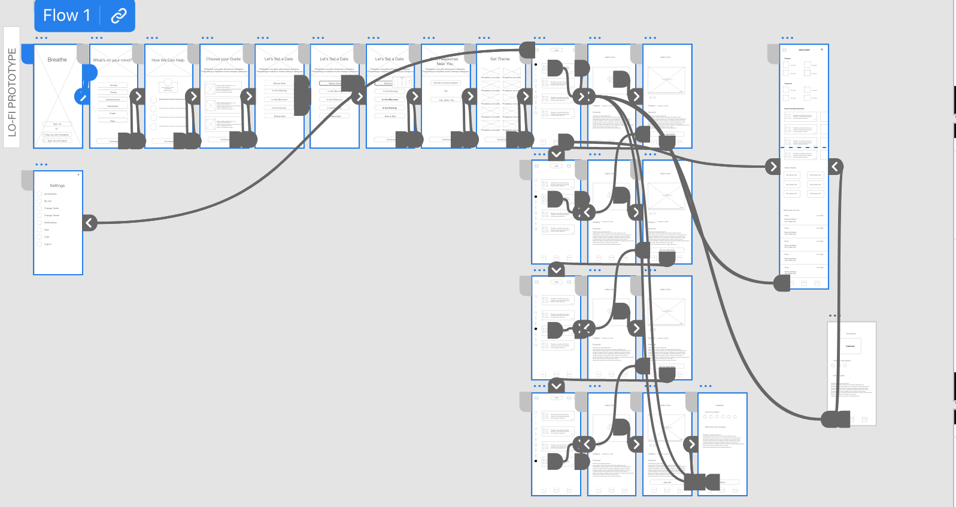
Low-fidelity prototype
Link to Low-fidelity prototype here

Slide 13
Usability study: parameters
Study type:
Unmoderated usability study
Location:
United States, remote
Participants:
5 participants
Length:
30 minutes

Slide 14
Usability study: findings
Insert a one to two sentence introduction to the findings shared below.
1
2
3
Account Setup
Journal Progress
Time Selection
Users wanted a more efficient way to create an account for the app.
Users expressed interest in being able to see progression of their mental state from their journals.
Users had difficulty selecting the time for notifications to do the daily tasks.

Slide 15
Refining
the design
Mockups
High-fidelity prototype
Accessibility

Slide 16
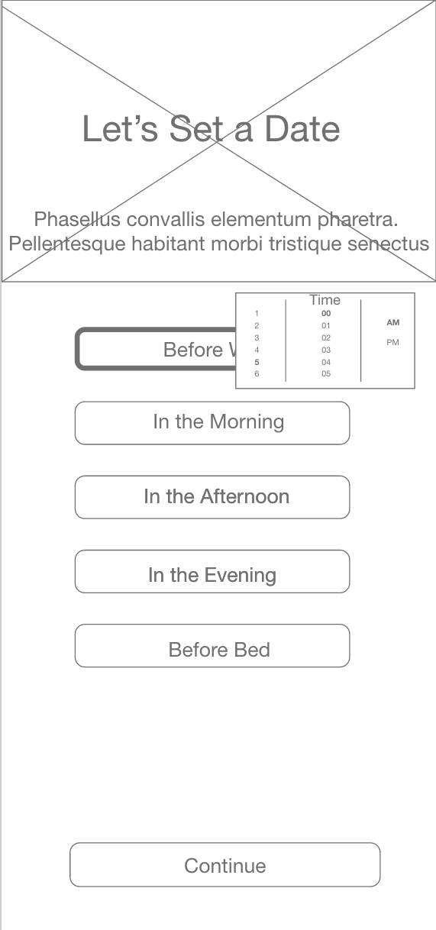
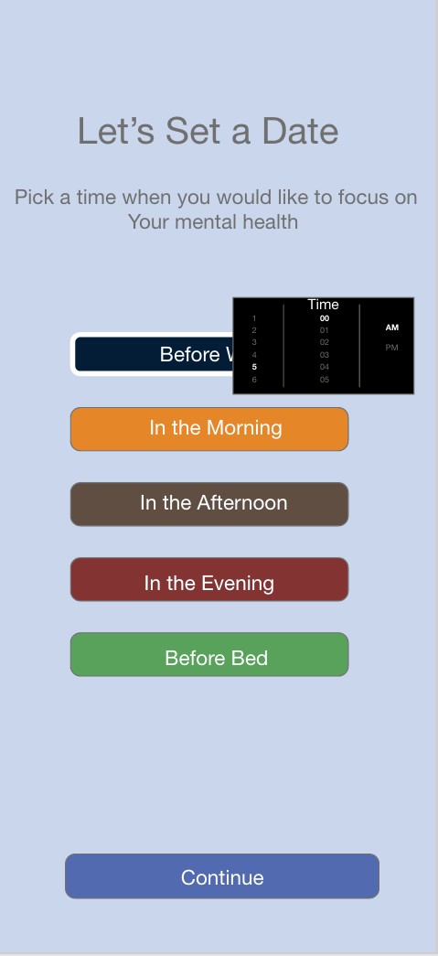
Before usability study
After usability study
Mockups
The goal in iterating this wireframe was to add color and change the type face to make it clearer on how to select the time. It is similar to that of the apple clock app.

Slide 17
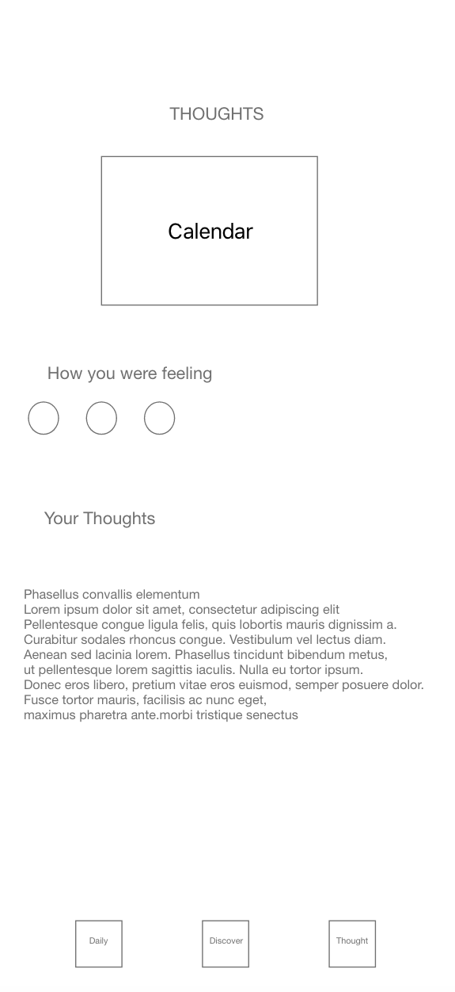
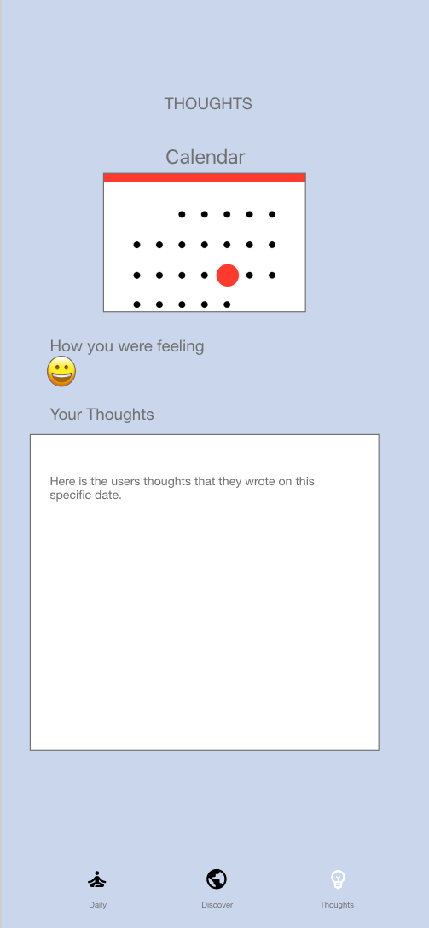
Before usability study
After usability study
Mockups
[The goal was to add an actual calendar the user can select any day from any month that they wrote a journal on and can look back at what they wrote and how they felt that day.

Slide 18
Main Mockups

Slide 19
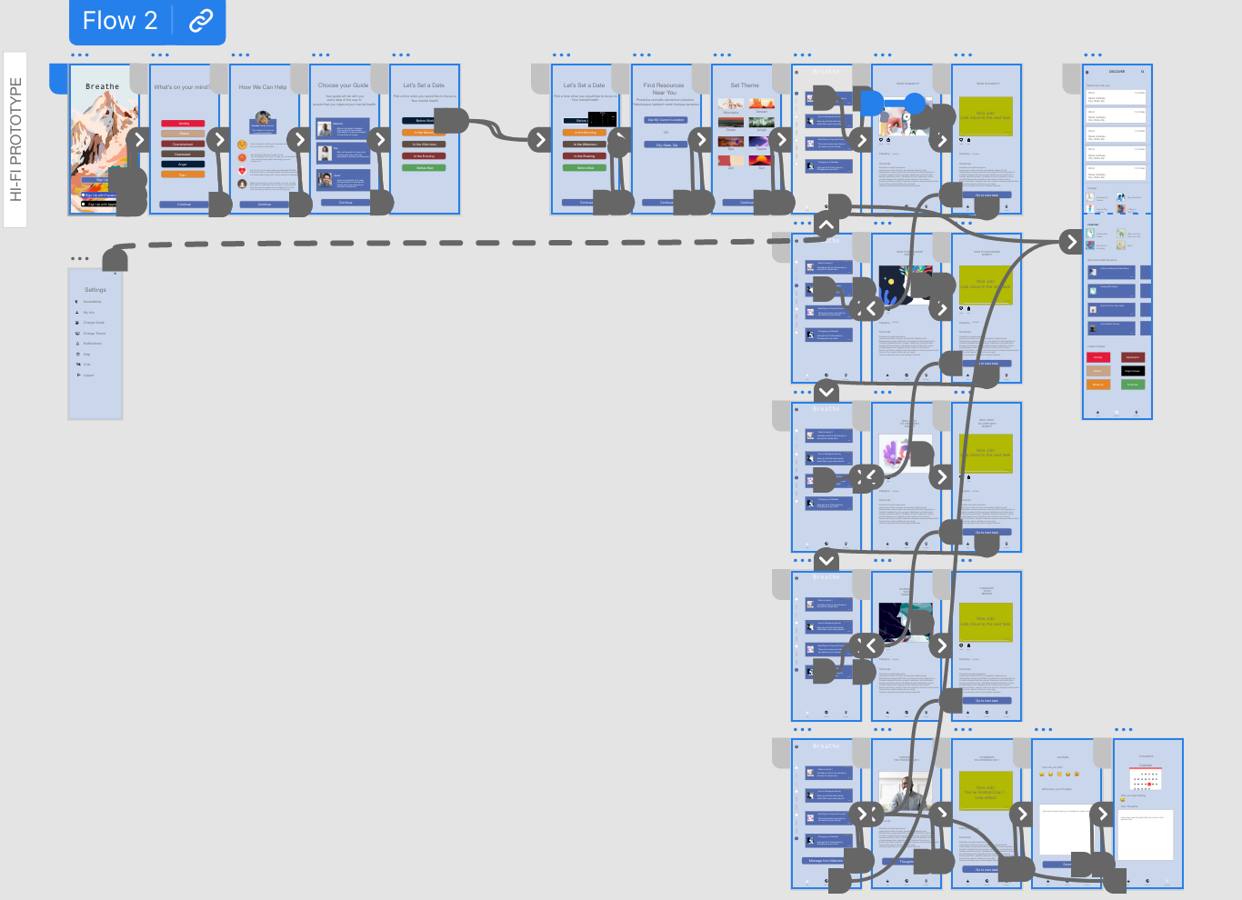
High-fidelity prototype
Link to high-fidelity prototype here

Slide 20
Accessibility considerations
1
2
3
When there is video content, users are able to see the words that are being said transcribed below the video as it is playing.
Users are able to change the accessibility settings to their preferred experience (i.e.. Dark mode, larger font, etc.)
The type face and color contrast makes the app readable for majority of users.

Slide 21
Responsive Design
Information architecture
Responsive design

Slide 22
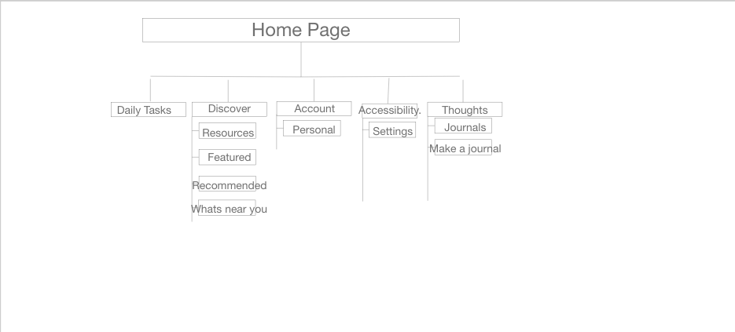
Sitemap
Here is a basic layout of what will be included in the website of the Breathe App.

Slide 23
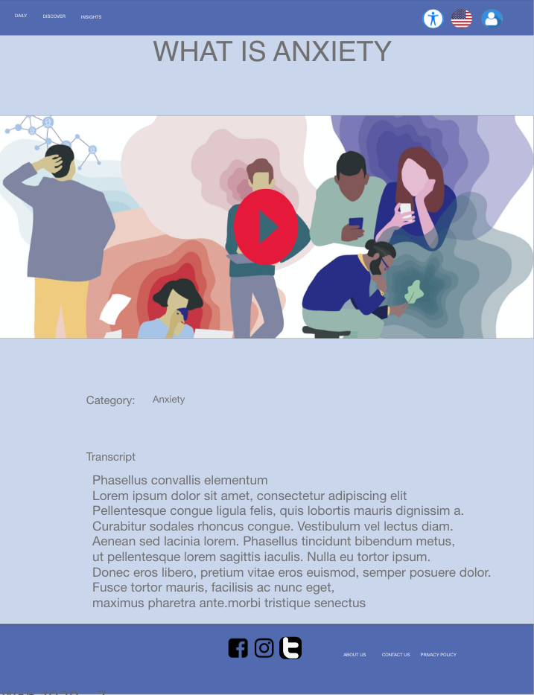
Responsive designs
The typeface, icons, and other elements of the mobile app have been adjusted to fit the needs of those that want to get on the website via desktop or laptop.

Slide 24
Going forward
Takeaways
Next steps

Slide 25
Takeaways
Impact:
Users that have participated in the study believe that this will make a big impact in their community, and that this resource is heavily needed.
What I learned:
Designing from the bottom up has its advantages and I am now aware of why this is such a popular design approach!

Slide 26
Next steps
1
2
3
Continue usability studies on different sizes of the app (mobile, desktop, and laptop website).
Continue to draw insights from usability studies to improve the user experience of the app.
Hand off to engineers to begin the development of the app.

Slide 27
Insert a few sentences summarizing the next steps you would take with this project and why. Feel free to organize next steps in a bullet point list.
Let’s connect!
Thank you for viewing my work! If you want to get in contact with me, reach me here:
Email: brianthompson072@gmail.com

